Slide 1

School of CIT – Social Computing Research Group
Advanced Natural Language Processing
CIT4230002
Prof. Dr. Georg Groh
Dr. Daryna Dementieva

Slide 2
Lecture 4 Text2Img Generation Models

Slide 3
Outline of the whole text2img block
Intro into text2img task
The evolution of text2img approaches and models
The state-of-the-art models
The mathematical background
The Diffusion Mechanism
Further Questions: Ethics and Research

Slide 4
Outline of the first lecture
Intro into text2img task
The evolution of text2img approaches and models
The state-of-the-art models
The mathematical background

Slide 5
Currently Available Text2Img Demos
(at least, about what we are aware of)
OpenAI DALLE·2: https://openai.com/blog/dall-e-now-available-without-waitlist/ and DALLE·3 with ChatGPT https://openai.com/dall-e-3
StableDiffusion: https://beta.dreamstudio.ai run on MAC: https://www.charl-e.com/
MidJourney: https://midjourney.com/

Slide 6
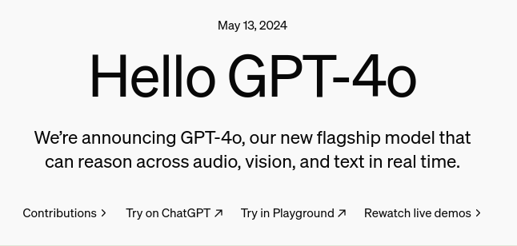
Currently Available Text2Img Demos
(at least, about what we are aware of)
https://openai.com/index/hello-gpt-4o

Slide 7
Be prepared for many images and videos!

Slide 8
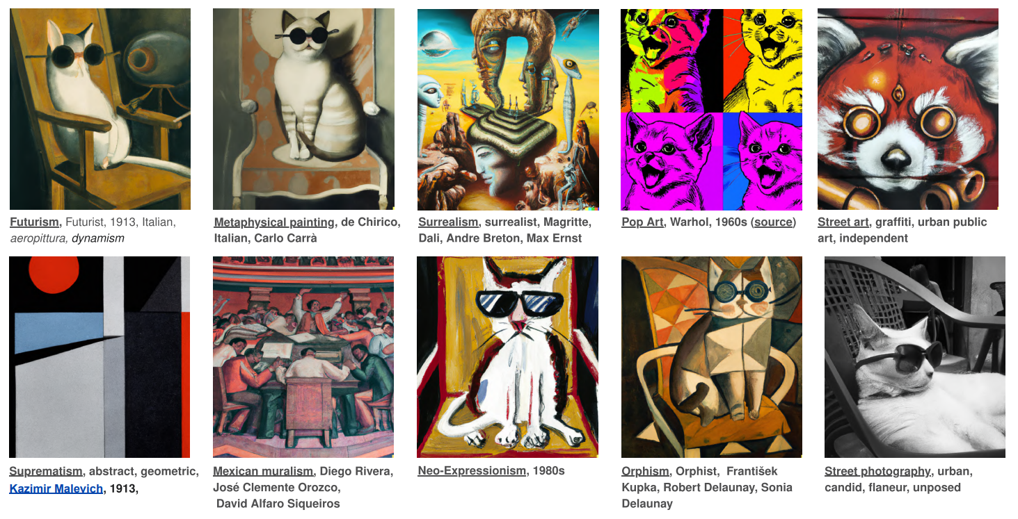
Big Hype
http://dallery.gallery/wp-content/uploads/2022/07/The-DALL%C2%B7E-2-prompt-book-v1.02.pdf

Slide 9




Big Hype

Slide 10
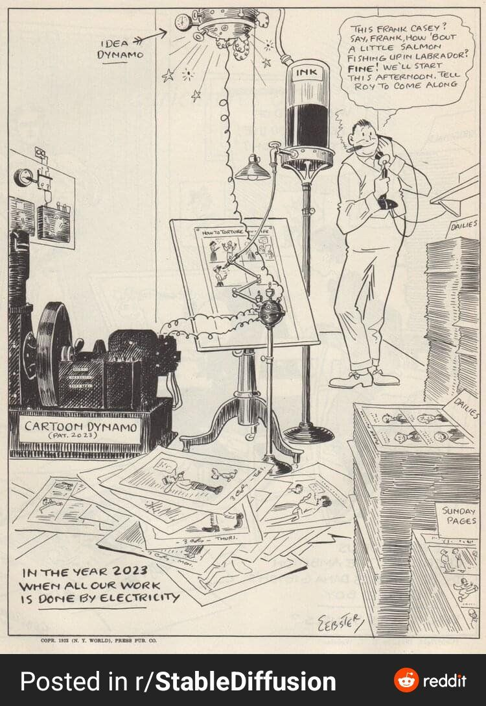
50-years old imagination about 2023…

Slide 11
Why do we do text2img?
It is fun!
It can help content creators to overcome a “cold start” problem;
It can help to automate some routine tasks of creators;
Photoshop “on steroids”;
Pushing the horizons of AI🚀

Slide 12
Outline
Intro into text2img task
The evolution of text2img approaches and models
The state-of-the-art models
The Diffusion Mechanism

Slide 13
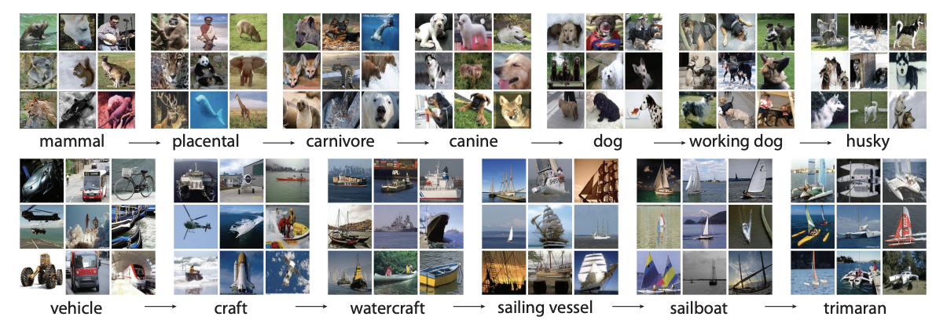
ImageNet (June, 2009)
ImageNet: A large-scale hierarchical image database 14,197,122 annotated images

Slide 14

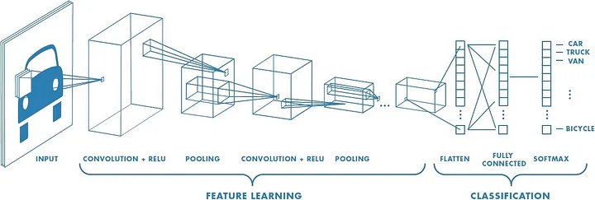
Image Classification SOTA (before Transformer era)
Convolutional Neural Network (CNN)
A Comprehensive Guide to Convolutional Neural Networks, Sumit Saha

Slide 15
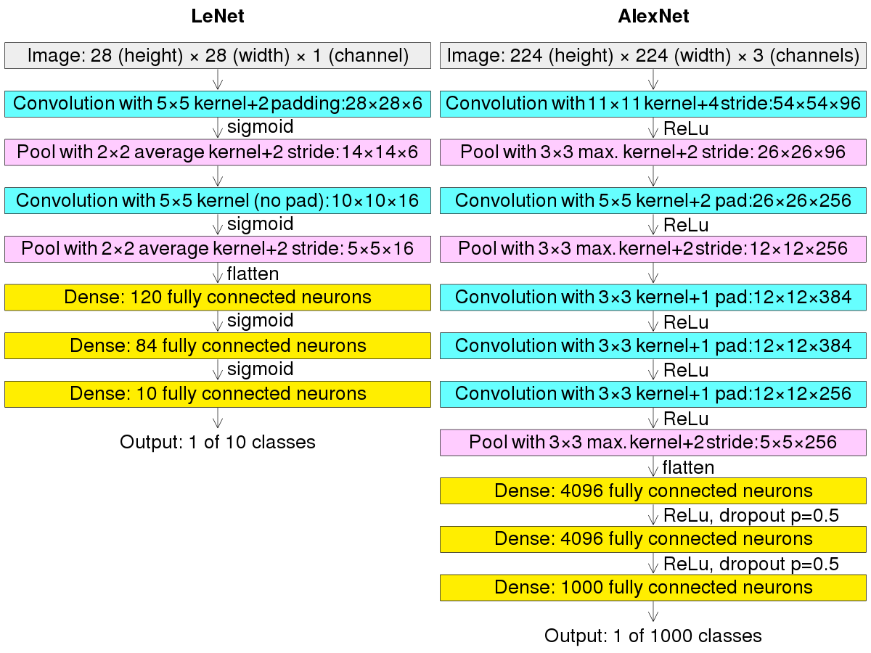
AlexNet (September, 2012)
The winner of “ImageNet Large Scale Visual Recognition Challenge” (84.7% vs 73.8% acc.)
Why?
The first indeed Deep CNN;
Data Augmentation;
ReLU activation function;
Dropout;

Slide 16

General Adversarial Network (GAN, June 2014)
https://sthalles.github.io/intro-to-gans/

Slide 17
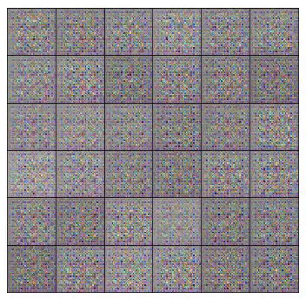
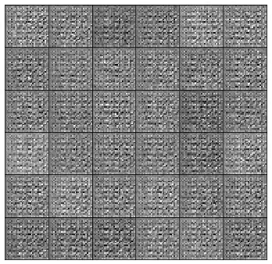
General Adversarial Network (GAN, June 2014)
https://sthalles.github.io/intro-to-gans/

Slide 18
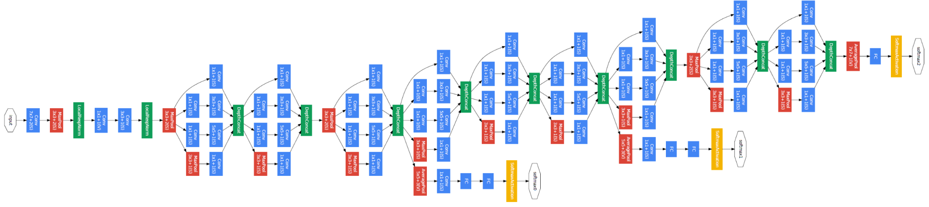

GoogleNet (September, 2014)
solved image classification and object detection task once again

Slide 19
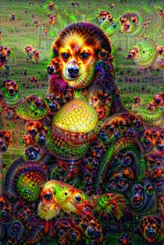
DeepDream (July, 2015)
“what patterns do you see in the image, now amplify it.”

Slide 20
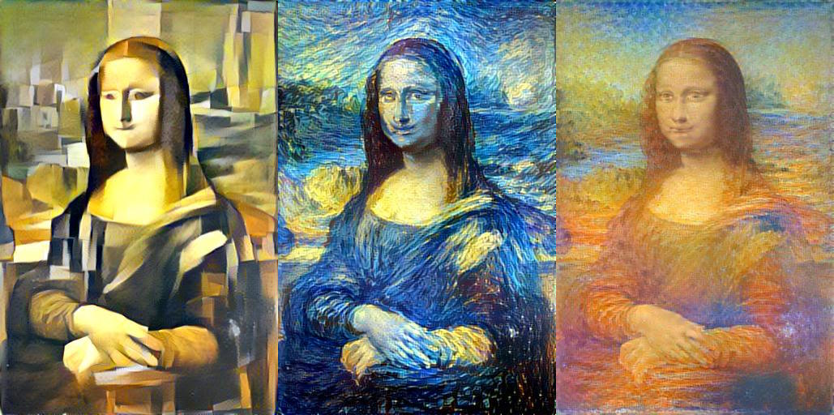
StyleTransfer (June, 2016)
Gatys L. A., Ecker A. S., Bethge M. Image style transfer using convolutional neural networks

Slide 21
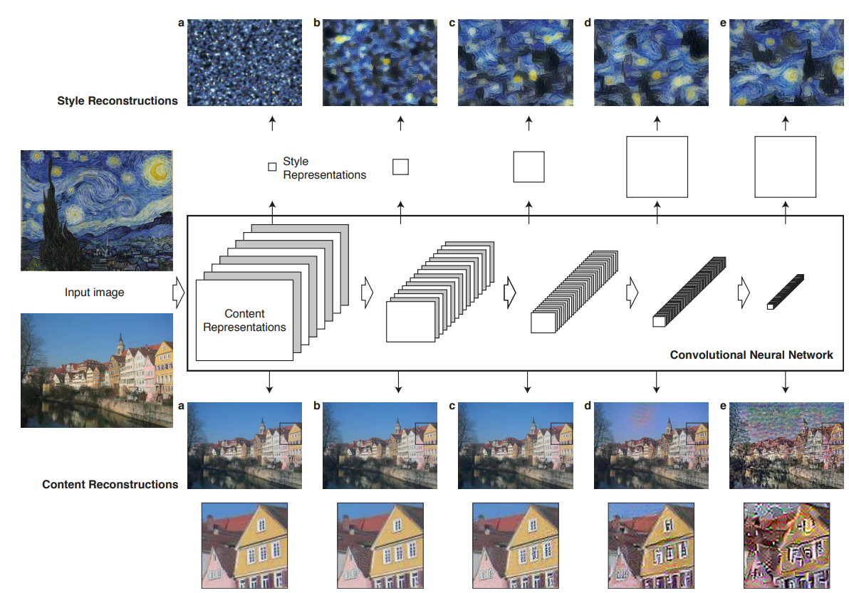
StyleTransfer (June, 2016)
Gatys L. A., Ecker A. S., Bethge M. Image style transfer using convolutional neural networks

Slide 22
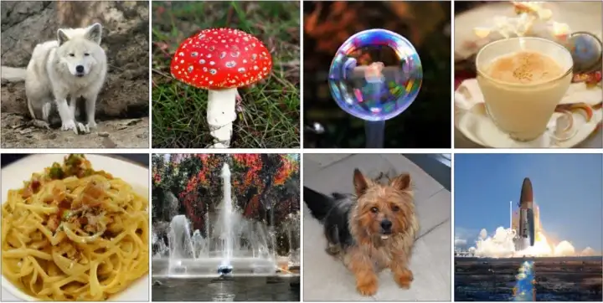

BigGAN (September, 2018)
Brock A., Donahue J., Simonyan K. Large scale GAN training for high fidelity natural image synthesis
Why?
Self-Attention GAN (SAGAN)
simple batch size increasing and model scaling;
HingeLoss;
and other;

Slide 23
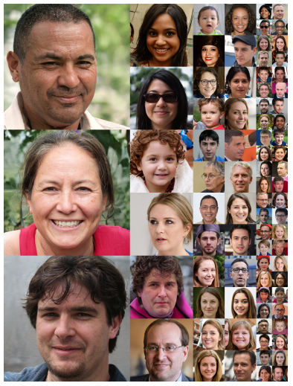
ThisPersonDoesNotExist (December, 2018/2019)
https://thispersondoesnotexist.com/

Slide 24
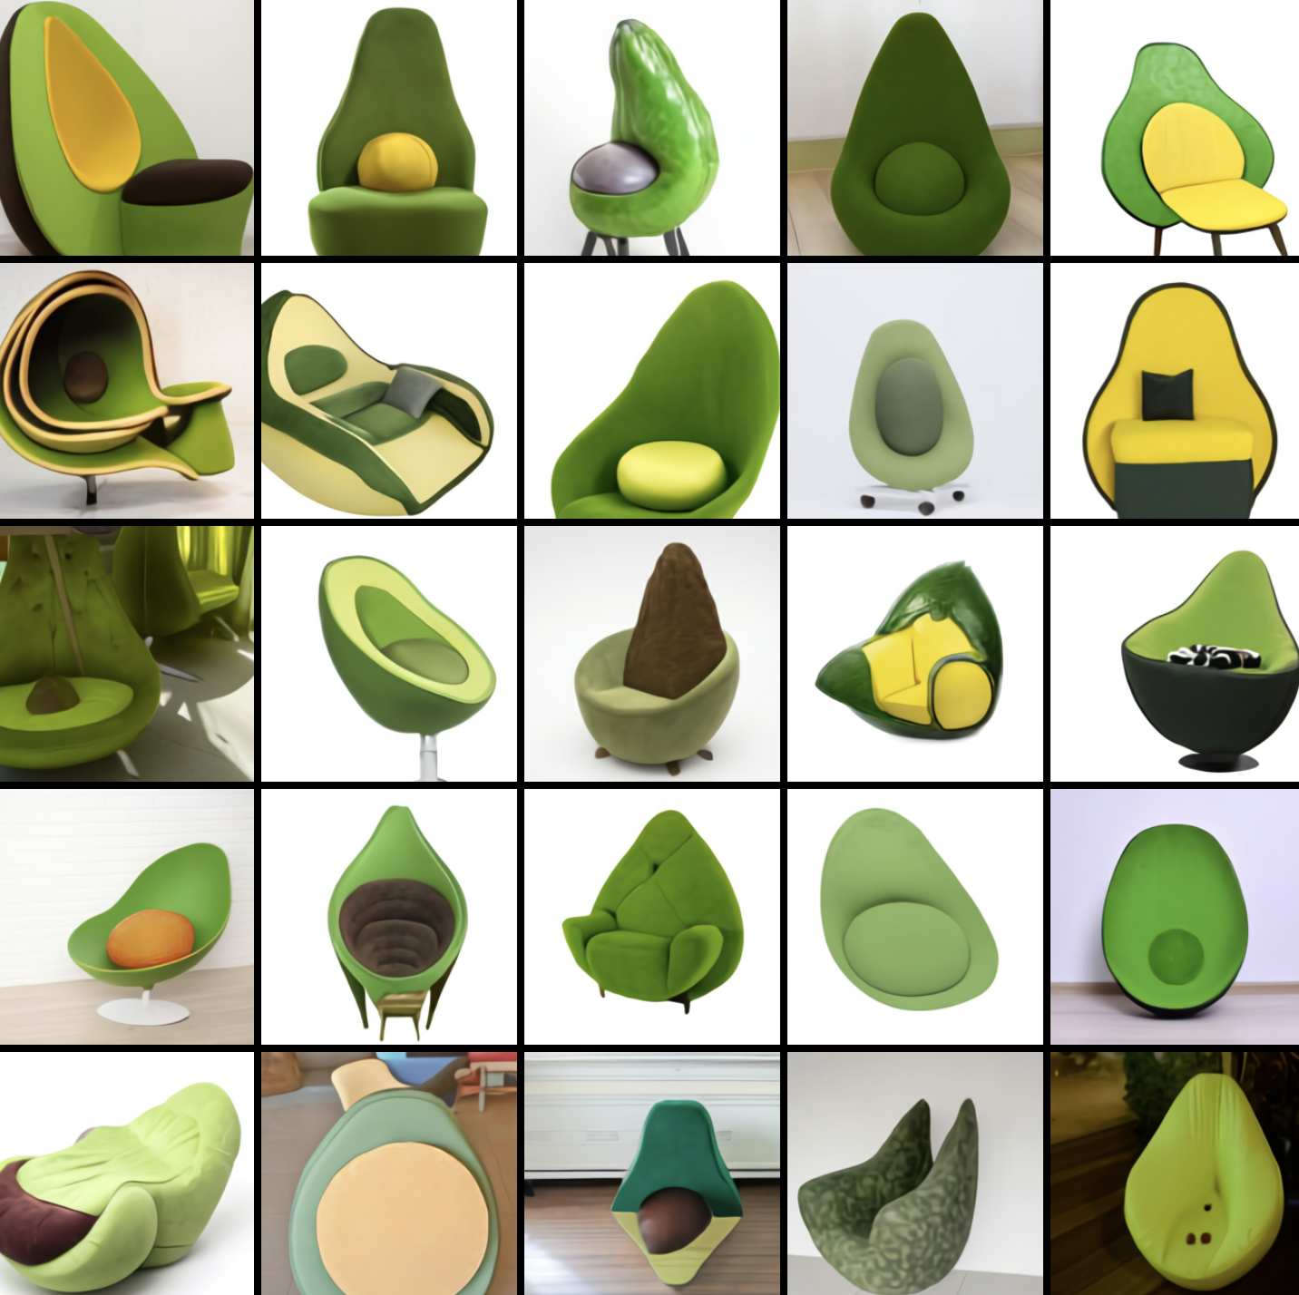
DALL·E (January, 2021)
2 years of development Why?
GPT-3 (#parameters: 12 billion);
400 million text2img pairs;
CLIP;
https://openai.com/blog/dall-e/

Slide 25

DALL·E (January, 2021)
2 years of development Why?
GPT-3 (#parameters: 12 billion);
400 million text2img pairs;
CLIP;
2018
2021
NON-OPENSOURCE
https://openai.com/blog/dall-e/

Slide 26
Outline
Intro into text2img task
The evolution of text2img approaches and models
The state-of-the-art models
The Diffusion Mechanism

Slide 27
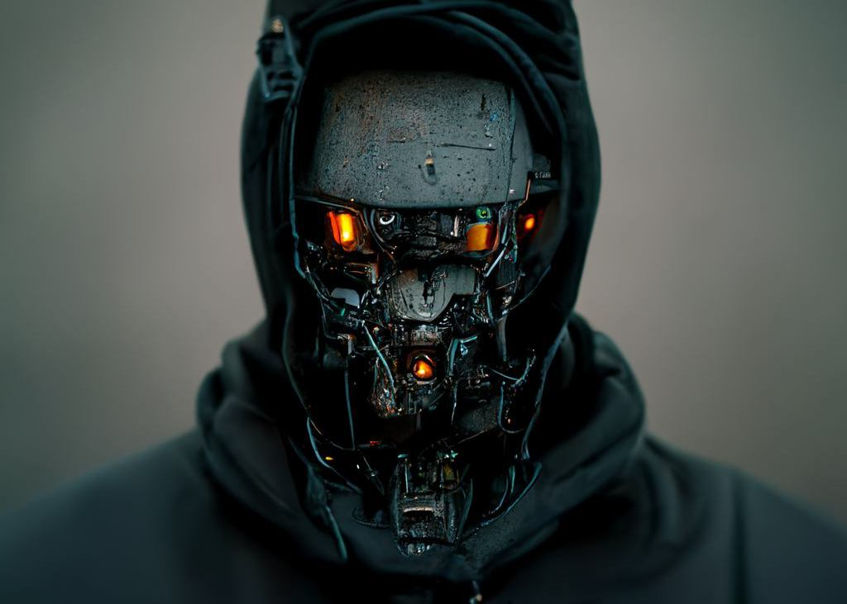
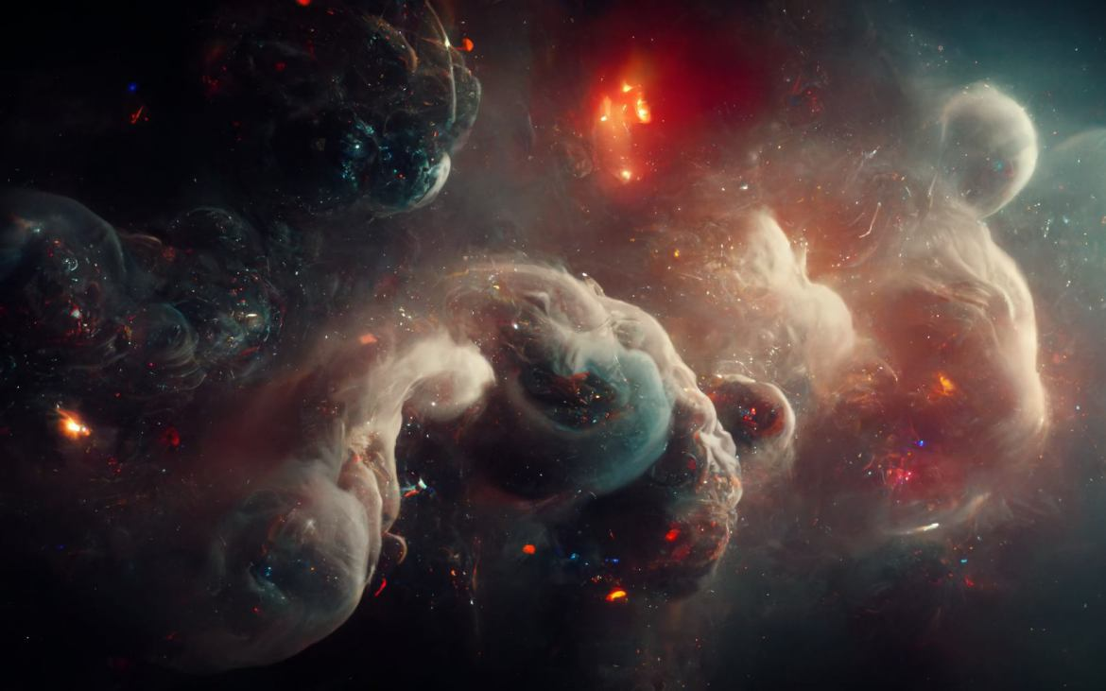
MidJourney (March, 2022)
https://www.midjourney.com/
NON-OPENSOURCE

Slide 28
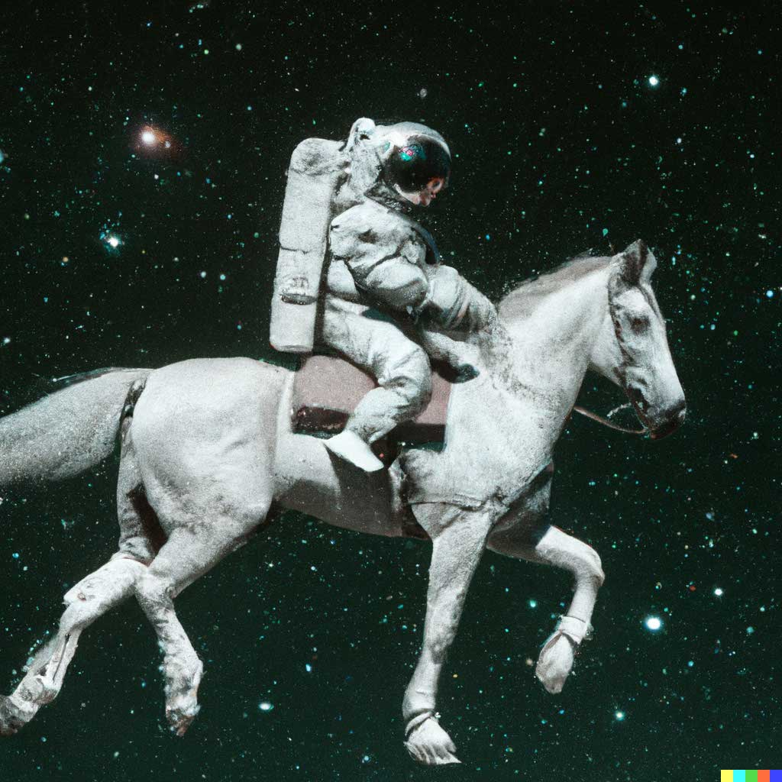
DALL·E 2 (April, 2022)
Why?
650 million image-text pairs;
but less parameters: 3.5B;
again CLIP;
Diffusion;
https://openai.com/dall-e-2/

Slide 29
DALL·E 2 (April, 2022)
Why?
650 million image-text pairs;
but less parameters: 3.5B;
again CLIP;
Diffusion;
2015 from non-equilibrium thermodynamics
NON-OPENSOURCE
https://openai.com/dall-e-2/

Slide 30
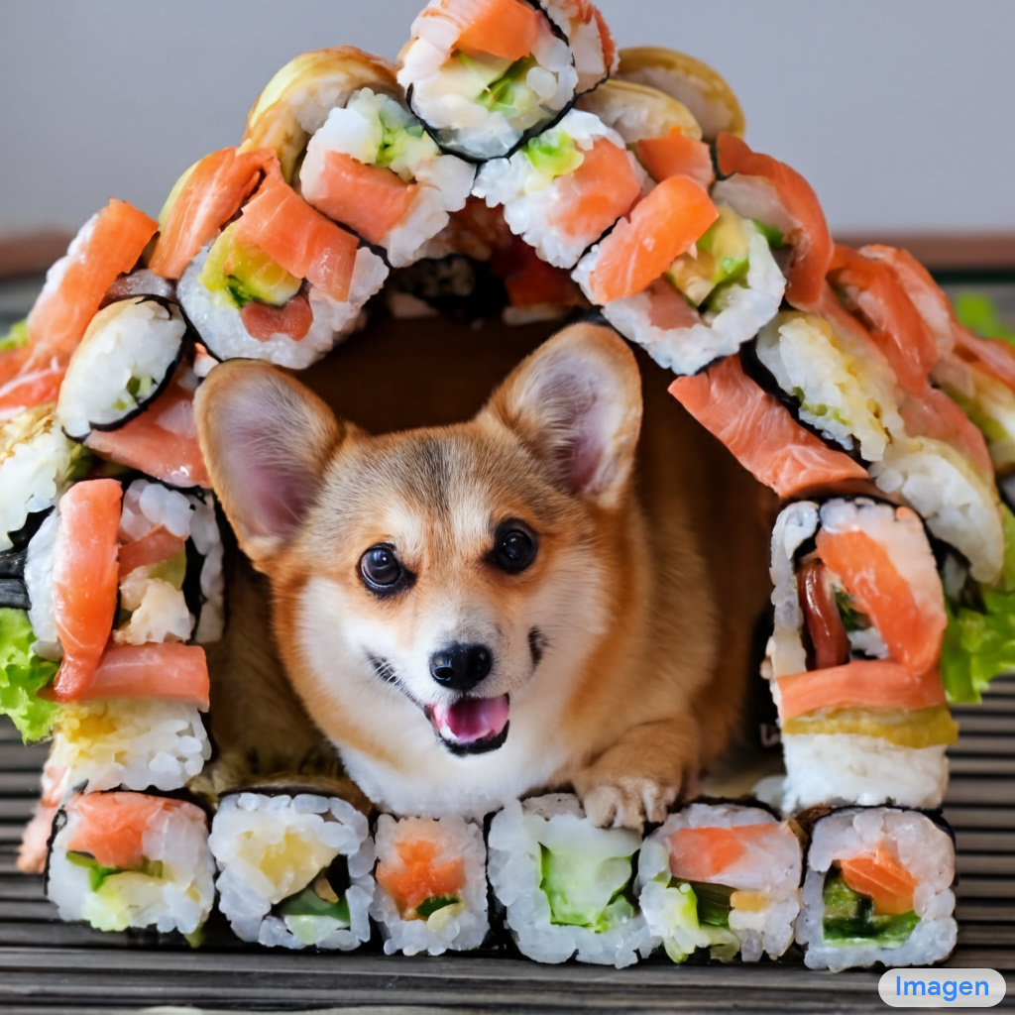
Imagen (May, 2022)
Why?
also CLIP;
also Diffusion;
(and even DALLE-2 samples);
language model: T5;
NON-OPENSOURCE
https://imagen.research.google/

Slide 31
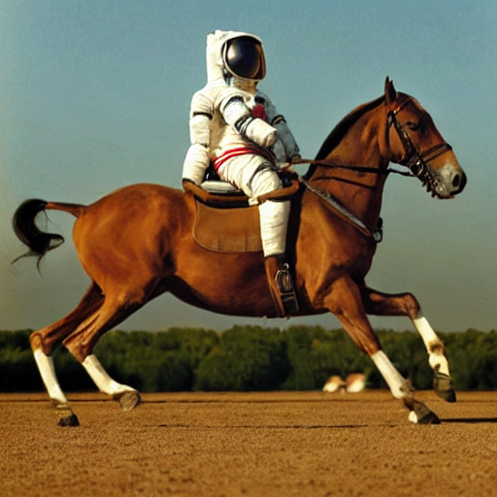

StableDiffusion (July, 2022)
Why?
also Diffusion;
but, latent (created by CompVis, LMU, December, 2021);
LAION-5B data (open, 5b pairs);
OPENSOURCE
https://stability.ai/

Slide 32
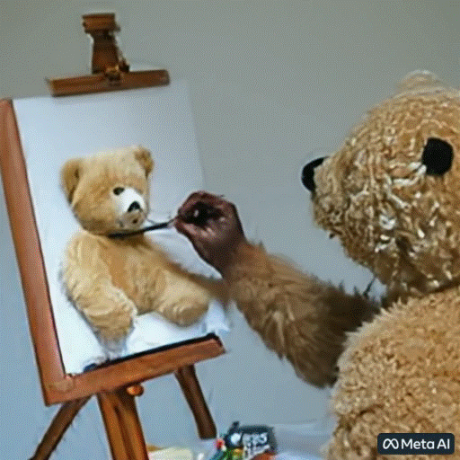
Make-A-Video (September, 2022)
“A video of a teddy bear painting a portrait”
https://makeavideo.studio/

Slide 33
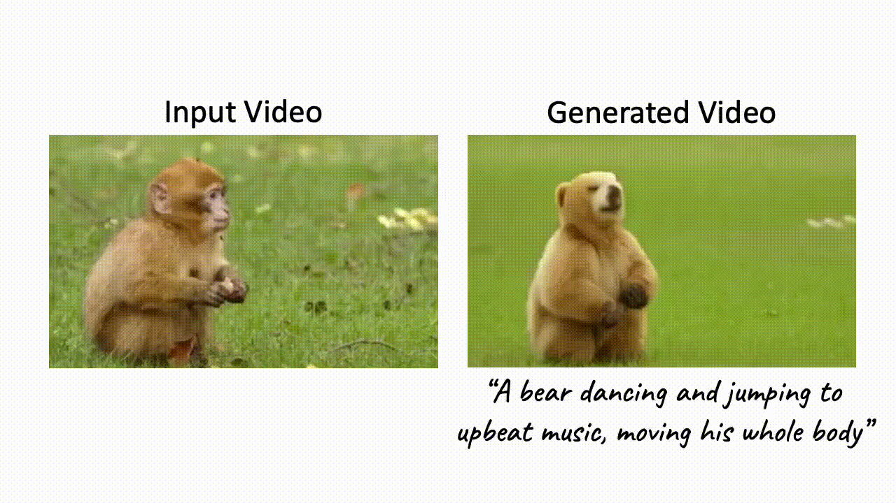
Dreamix (2 February, 2023)
https://dreamix-video-editing.github.io/

Slide 34
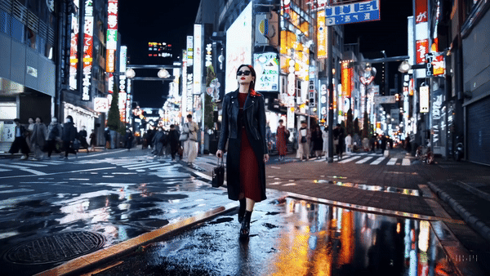
Sora (February, 2024)
“A stylish woman walks down a Tokyo street filled with warm glowing neon and animated city signage. She wears a black leather jacket, a long red dress, and black boots, and carries a black purse. She wears sunglasses and red lipstick. She walks confidently and casually. The street is damp and reflective, creating a mirror effect of the colorful lights. Many pedestrians walk about.”
https://openai.com/sora

Slide 35
Outline of the first lecture
Intro into text2img task
The evolution of text2img approaches and models
The state-of-the-art models
The mathematical background

Slide 36
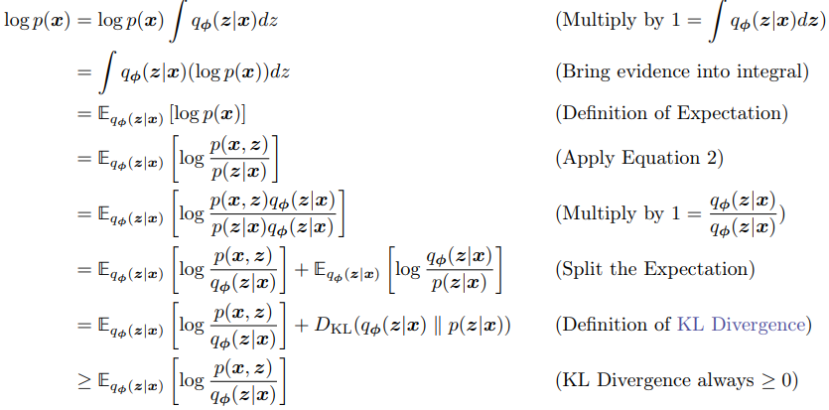
Evidence Lower Bound (ELBO)
Understanding Diffusion Models: A Unified Perspective

Slide 37
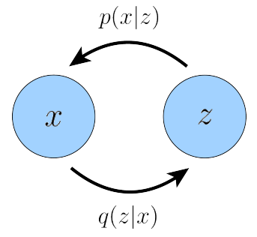
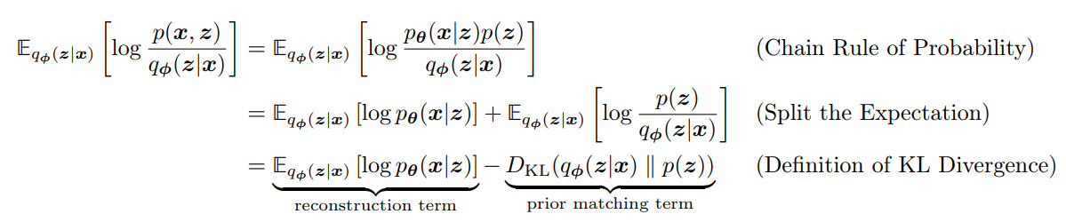
Variational Autoencoder (VAE)
Understanding Diffusion Models: A Unified Perspective

Slide 38
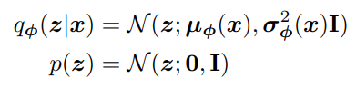
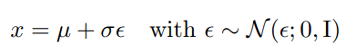
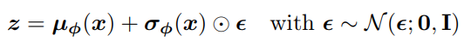
Variational Autoencoder (VAE)
Understanding Diffusion Models: A Unified Perspective

Slide 39
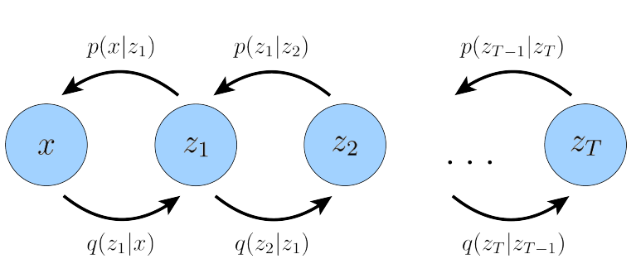
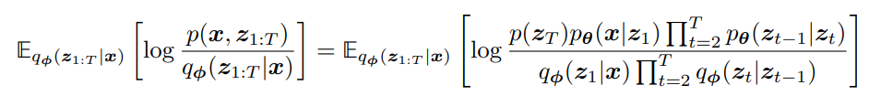
Hierarchical VAE
Understanding Diffusion Models: A Unified Perspective

Slide 40
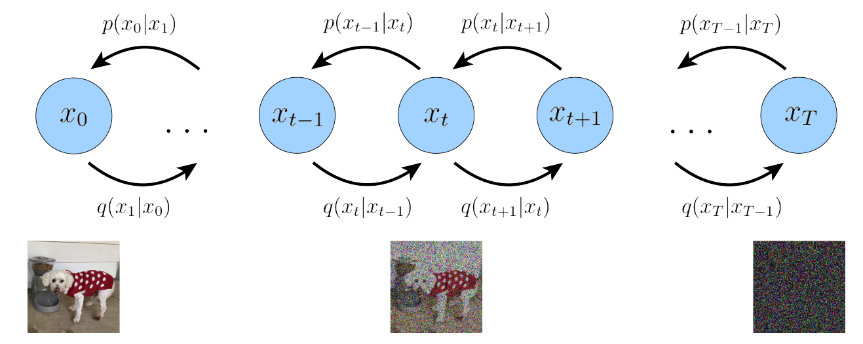
Variational Diffusion Models
Understanding Diffusion Models: A Unified Perspective

Slide 41
Bibliography
AI Timeline Visualization
Fast.AI Course “From Deep Learning Foundations to Stable Diffusion”
The Illustrated Stable Diffusion
Understanding Diffusion Models: A Unified Perspective
HuggingFace Tutorials
AI Watermarking 101: Tools and Techniques

Slide 42
See you next time!

